Slide 1

Microsoft AL
GUI & In-Client Designer IV

Slide 2



Prerequisite
Use Workshop-VM / Workshop-Computer follow the instructions of the Boarding Pass
Visual Studio Code
https://code.visualstudio.com
Competence Team DevTech
Microsoft AL

Slide 3
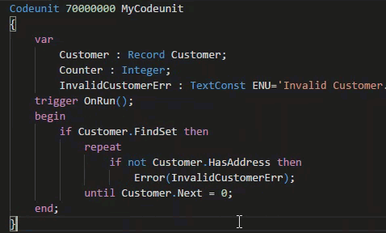
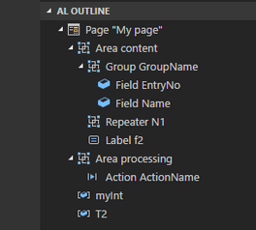
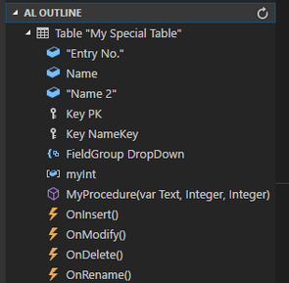
VS Code Useful Extensions
AL Formatter
Indentation
Keyword case style
Sort variable definitions
Readability Guidelines - Spacing and newlines (experimental)
AL Code Outline
Outlining – AL Object Structure
“Create List Page” from Table
“Create Card Page” from Table
al-util
“Rename & Move” Objects
Templates e.g. “Readme.md”

Slide 4
GUI & In-Client Designer Agenda
1
Language & Types (Re-Cap)
2
Wizard (Re-Cap)
3
Json, List, Dictionary
4
Assisted Setup
5
Hands On

Slide 5

Microsoft AL
Language & Types
Re-Cap

Slide 6
Microsoft AL Language & Types
Recommendation for VS Code
1 File per Object
Organize Object Files in Folders (Pages, PageExtension, …)
Use Snippets in AL
ttable
tpageext
tcodeunit
…
Documentation - Development in AL
https://docs.microsoft.com/.../developer/devenv-dev-overview
C/Side | Microsoft AL
 | Extending | New
Codeunit | - | codeunit
Table | tableextension | table
Page | pageextension pagecustomization | page
XMLport | - | xmlport
Query | - | query
Report | - | report
Menu Suite | - | -
 |  | profile
 |  | controladdin

Slide 7

Improve the UX
Features
Wizard (Re-Cap)
New Datatypes
Assisted Setups

Slide 8
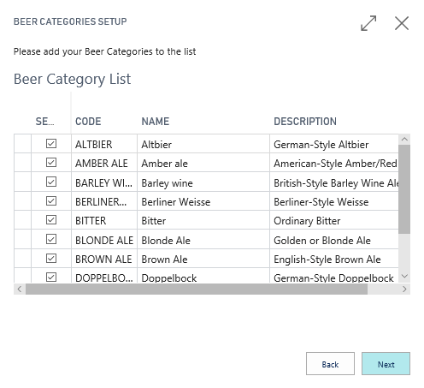
Pages in Microsoft AL Wizard (Re-Cap)
Wizards
Object Type Page (Navigation)
Groups InstructionalText
Actions
Back, Next, Finish Visibility depends on Page
Properties InFooterBar
Groups = Wizard Pages Show / Hide for each Page
Start Page / Welcome Introduktion
Page XYZ
Finish Page Summary

Slide 9
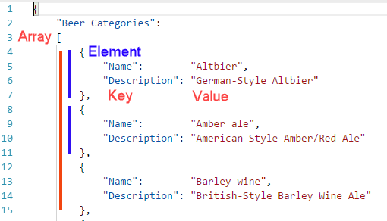
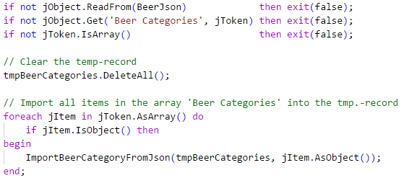
Pages in Microsoft AL Json
JsonObject
.Get( <Name>, jToken)
.ReadFrom(…) / .WriteTo(…)
.SelectToken(…)
JsonArray
ForEach Item in Array do begin /* Loop */ end;
Item JsonToken
JsonToken & JsonValue
.IsObject() .AsObject()
.IsArray() .AsArray()
.IsValue() .AsValue().IsNull() / .IsUndefined() .AsValue().AsText() .AsValue().AsDate()

Slide 10
Pages in Microsoft AL List & Dictionary & TextBuilder
Datatype List represents a strongly typed list of value
var <Name>: List of [<Datatype>];
.Contains( <item> )
.Add( <item> )
.Remove( <item> )
Datatype Dictionary represents a collection of keys and values
var <Name>: Dictionary of [<Key Datatype>, <Value Datatype>]
.ContainsKey( <key> )
.Add( <key>, <value> )
.Remove( <key> )
Datatype TextBuilder can performantly concatenate multiple bigger strings together
.Append(<text>)
.ToText()

Slide 11
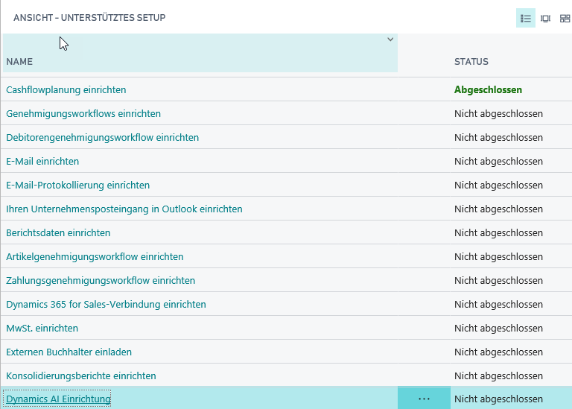
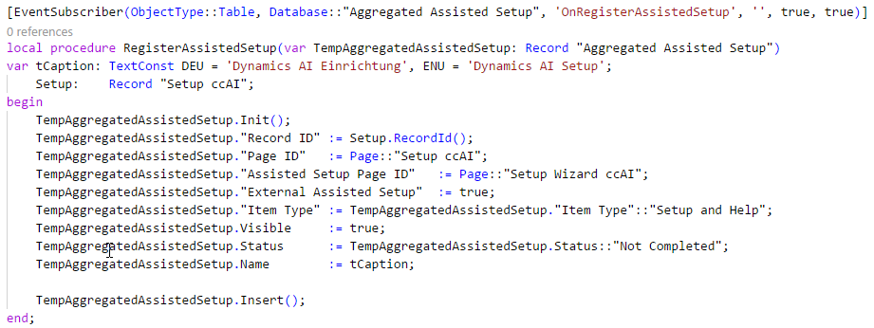
Pages in Microsoft AL Assisted Setup
Assisted Setup
Registration of individual Setups
Register a Page / Wizard
Record “Aggregated Assisted Setup”
Event “OnRegisterAssistedSetup”

Slide 12
It’s Lab Time
Hands On
Wizard

Slide 13
Pages in Microsoft AL Hands On
Material
Project Skeleton „02-GUI-&-In-Client-Designer\Starter\04 My Favorite Beer\”
Tables: „Beer Category”
Tables.Extensions: „Customer”, „Item”
Pages: „Beer Wizard [CC]”
Assets
“BeerCategories.json”
Prerequisites
Connect to your Workshop VM → use Instructions on your Workshop Boarding Pass
Hand On - Tasks
Complete the Setup Wizard to initialize Beer Categories and use a List Part for Table “Beer Category”
Register the Wizard as Assisted Setup

Slide 14
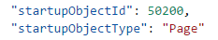
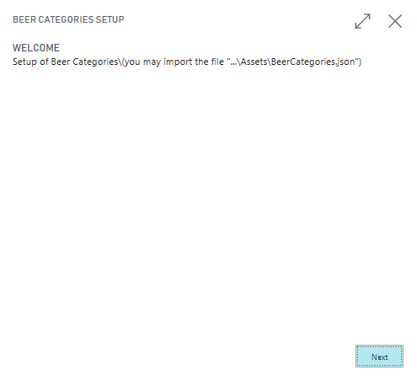
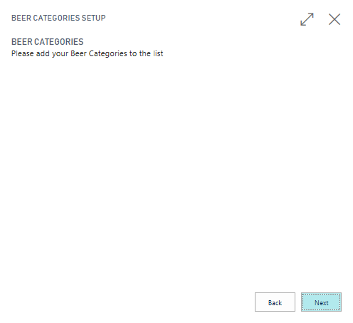
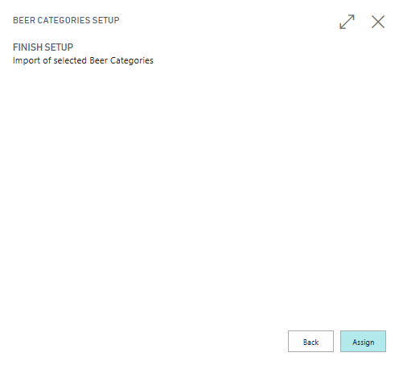
Pages in Microsoft AL Hands On – Wizard
Call the Wizard by changing the “launch.json” StartupObject information
The Wizard skeleton looks like this:

Slide 15
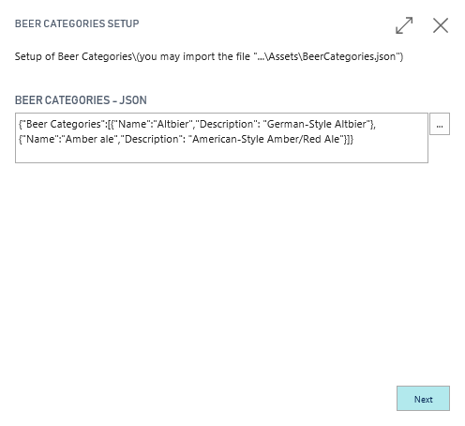
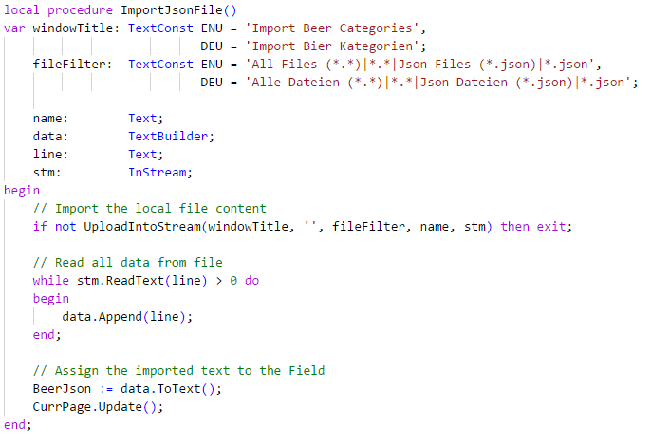
Pages in Microsoft AL Hands On – Wizard
Improve Page "Welcome“
Add and Initialize a Multiline Textfield with a Json content
Add an Assisted Edit trigger to the field, which import (read) the Json content from File into the variable BeerJson : Text

Slide 16
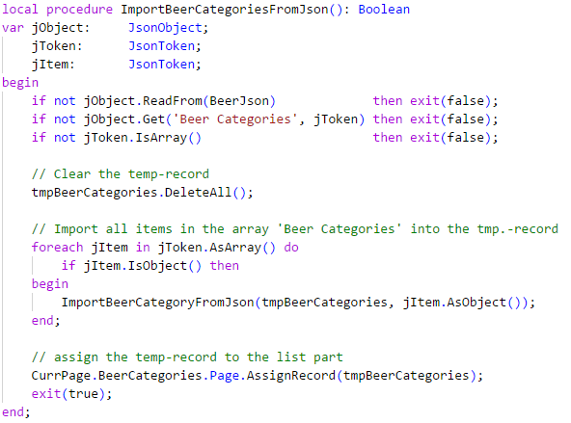
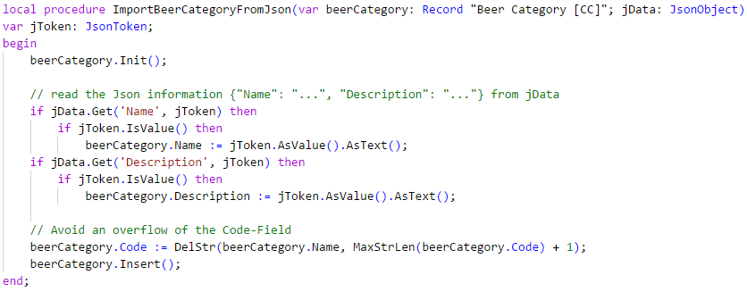
Pages in Microsoft AL Hands On – Wizard
Improve Page “Beer Categories“
Add a List Part “Beer Category Sub [CC]” ID 50203 which allow the selection of categories
Add a temp. Record “Beer Category [CC]” to the wizard
Read the Json Content into the record during page change “Welcome” → “Beer Categories”
Assign the Record to the List Part

Slide 17
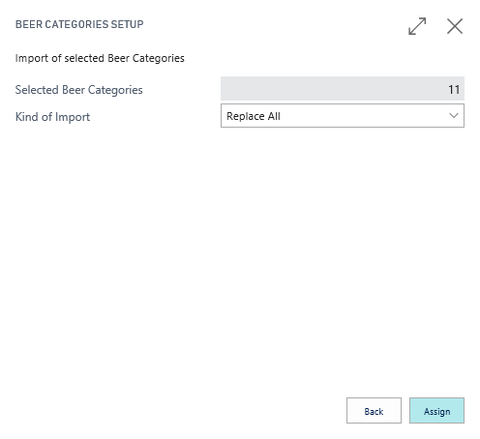
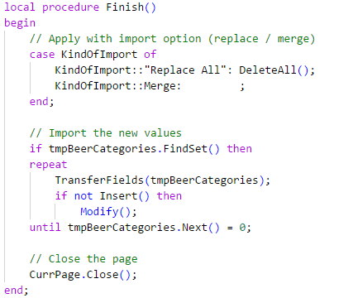
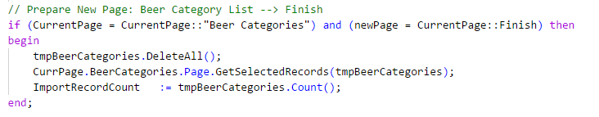
Pages in Microsoft AL Hands On – Wizard
Improve Page “Finish“
Add an Information Field “Count of Selected Records”
Add an Option Field with values “Replace All” and “Merge”
Update the value of the Information Field, when the page changes “Beer Categories” → “Finish”
Use the Option Information, when the user press “Finish” and apply the content of the temp. record “Beer Categories” to the database and close the wizard

Slide 18
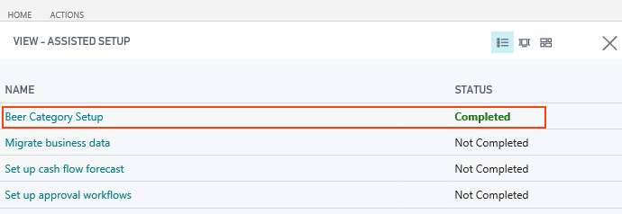
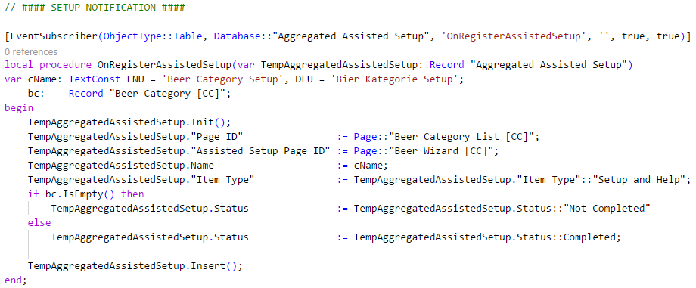
Pages in Microsoft AL Hands On – Notification & Assisted Setup
Use Code Unit „Beer Mgt. [CC]“ ID: 50201
Register the Wizard as Assisted Setup
Use the Correct Event Subscriber
Add the temporary Record

Slide 19

Q & A
Visual Studio Code
https://code.visualstudio.com
Competence Team DevTech
Channel Microsoft AL

